Slide 1
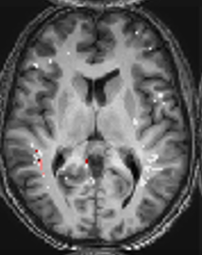
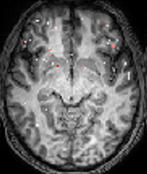
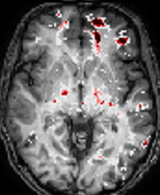
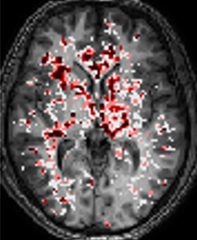





FIGURE 1: Epilepsy vs controls
A BBBD maps
2 3 4
1
5
4
3
B Regional Analysis
Z score
2
0
C Whole brain
D Regional analysis
Figure 1 DCE-MRI reveals persistent BBBD in epileptic patients. .(A) Examples of patients BBBD analysis results. 1 – healthy control. 2 – Left temporal epilepsy. 3 – Left frontal epilepsy. 4- Generalized epilepsy. (B) Examples of z-score 124 regions BBBD maps. Z-score between 0-2 is transparent. (C). Statistics of BBB% between controls and patients with epilepsy. (D) Statistics of Percent of regions with BBBD between controls and patients with epilepsy.
Notes:
Epilepsy 1 – AB_1866LFT
2 - MH 4108 LF
3 - WS_7206 G
Controls
1 – AN 0207
2 – HS 5404

Slide 2
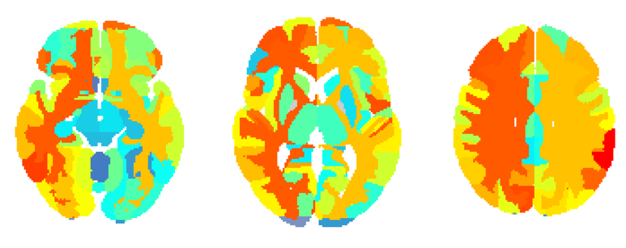
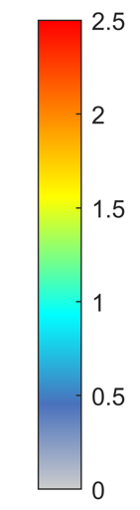
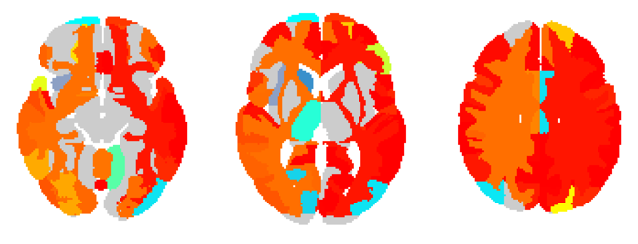
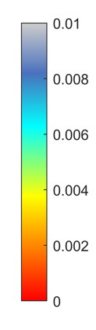
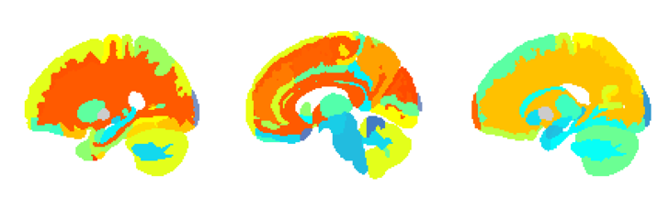
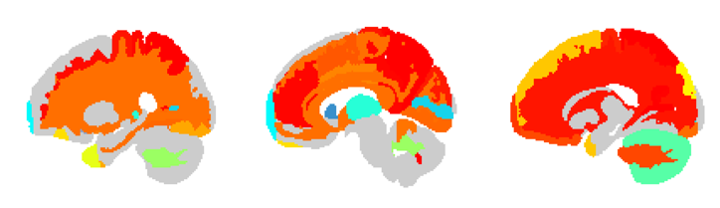
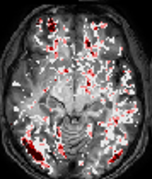

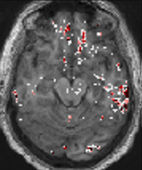

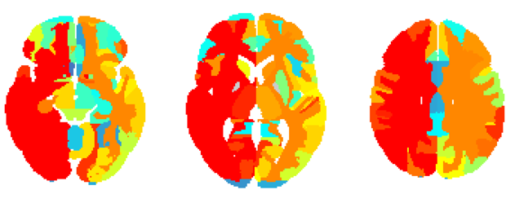
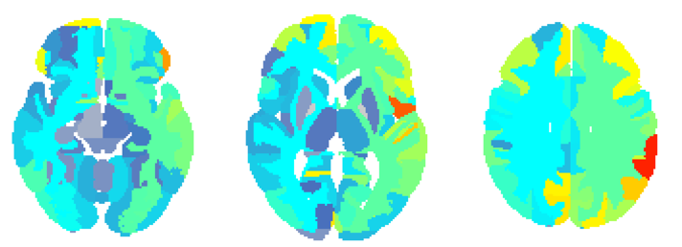
FIGURE 2: Regional analysis
A All PWE vs. controls
B All PWE vs. Controls
^{x}10⁻³
2.5
1
2
8
1.5
6
Z score
P value
1
4
0.5
2
0
0
C Generalized
D Suspected temporal
5
4
3
Z score
2
0
2.5
2
1.5
Zscore
1
0.5
0
E All Patients
F
G Brain regions with BBBD
Figure 2 . (A) Averaged z-score above controls in regional maps of 126 areas. (B) Significant regions of patients with epilepsy compared to controls p<0.001. (C) 1. Example of patient with generalized epilepsy. Color bar same as fig.1. 2. Average z-score above controls in regional maps of generalized epilepsy (D) 1. Example of patient with suspected temporal epilepsy. Color bar same as fig.1 2. Average z-score above controls in regional maps of suspected temporal epilepsy (E) Averaged z-score per region of patients with epilepsy compared to controls (F) Averaged z-score of generalized and focal epilepsy per region. (G) Percent of patients with averaged z-score >2 from controls.
Notes:
Examples:
EA 0804
LL 0265
BT 3007 – left side
Optional:
AF7084 – linear and tofts diffuse
BA 5372 – linear G and tofts F

Slide 3
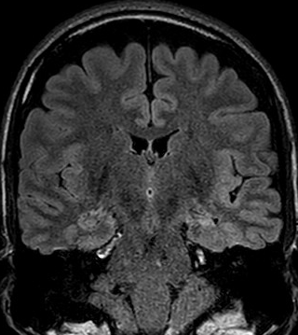
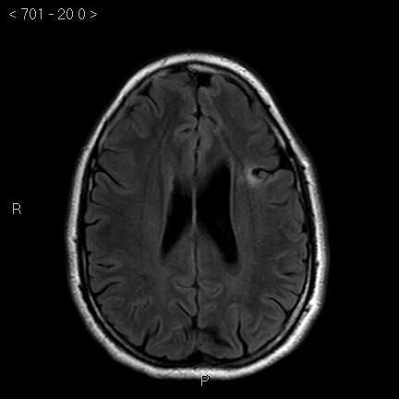
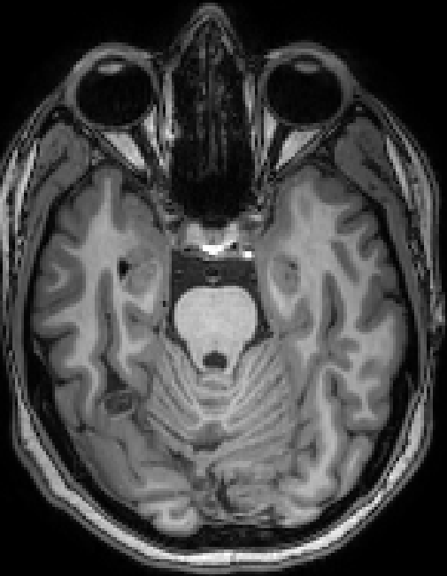
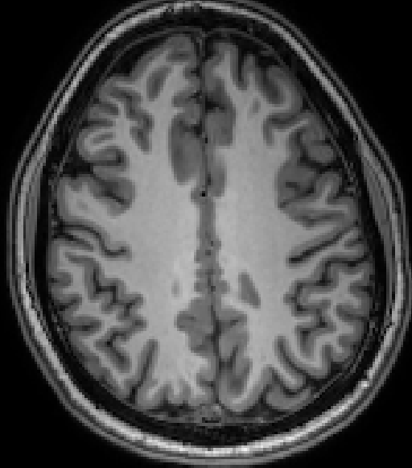
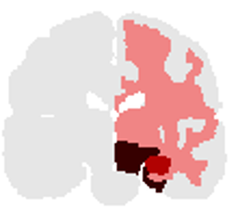



FIGURE 3: Lesion and BBBD
A
B
C
5
4
3
Z score
2
0
D E F
Figure 3 . BBBD in patients with a “lesional MRI”: A: 35 yo male with left hippocampal sclerosis. B: 33 yo man with left frontal cortical dysplasia. C: 20 yo female with right occipital cavernoma. Upper row: representative anatomical images showing the lesion (red circle). Lower row: regional analysis of BBB leakage.
D: Whole brain BBBD volume in Z score compared with controls. E: % of regions (out of 123) with BBBD (Z score > 2). F: Location of region(s) with maximum BBBD in relation to lesion site. For more details see Table
Notes:
A - MH_4108
B - BT_3007
C - RS_7023

Slide 4
FIGURE S1: Demographics
A Age
B Gender
C Age of onset
D Years of epilepsy
E Seizure frequency
Figure 2 . (A) Average percent of regions with BBBD versus age (p=0.63). (B) Average percent of regions with BBBD by gender (p=0.058). (C) Average percent of regions with BBBD versus age of onset (p=0.22). (D) Average percent of regions with BBBD versus years of epilepsy (p=0.79). (E) Average percent of regions with BBBD versus seizure frequency (p=0.39).

Slide 5
FIGURE S2: Medicine
A Medication
Figure 2 . (A) Average percent of regions with BBBD by number of medications taken (N(0,1) = 17, N(2)=14, N(3+)=19. p(1,2 )=0.65 , p(1,3)=0.14 , p(2,3)= 0.46). (B) (C) (D)

